Slide 1

Linear Regression
Teoh Teik Toe
ITOM/NBS
ttteoh@ntu.edu.sg
97905202

Slide 2
Reading before class
Regression : https://www.dropbox.com/sh/dcz4m1ps91mimzz/AACBicbA3-KABogiJ3iWu5N9a?dl=0
Quantile : https://www.dropbox.com/sh/lickupqy8lkcol4/AAAQGMg8j8UQYWM8Tg25duEva?dl=0
Mars : https://www.dropbox.com/sh/fdqwz0elrgeww1c/AADWRzjIRqqspuKsz0sxZI24a?dl=0

Slide 3
Agenda
Intro to Linear Regression
DBS (Regression)
Equity Financial Data (Classification)
Treynor (Regression)
Review

Slide 4
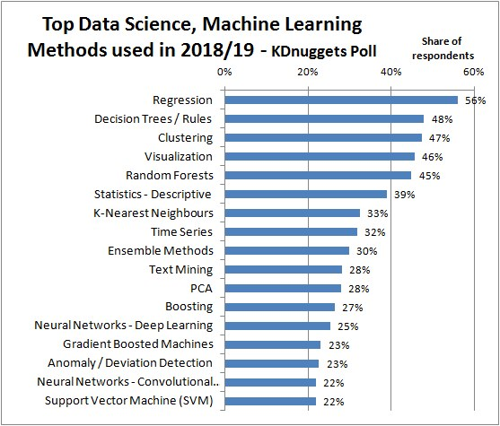
https://images.app.goo.gl/RZL5fApQc5t4syyr5

Slide 5
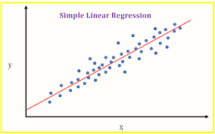
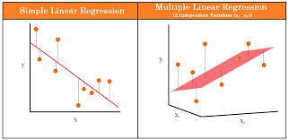
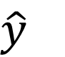
Linear Regression Model Line
Coefficient – Try and Error (Brute Force)
$y=b_{0}+b_{1}x_{1}+b_{2}x_{2}+…+b_{m}x_{m}+e$
$\hat{y}$
Must be normally distributed
Use QQ Plot test

Slide 6
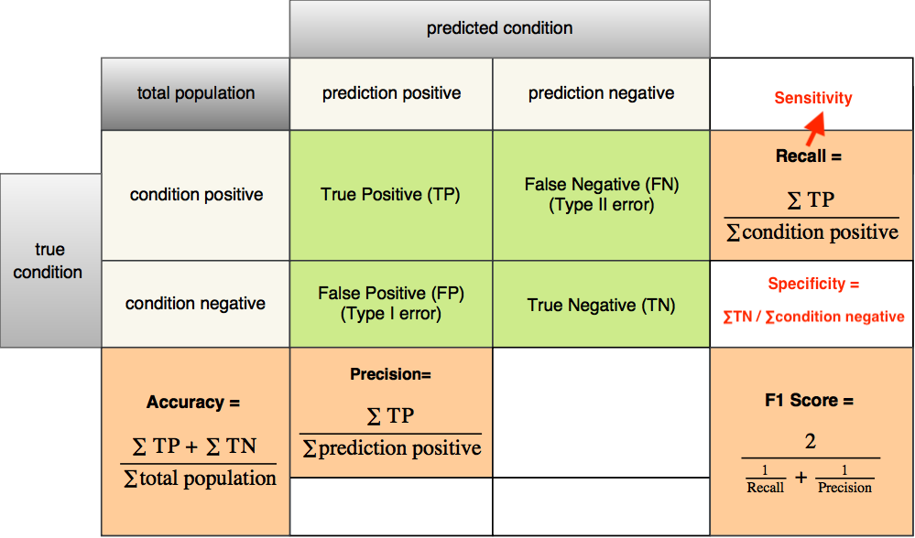
Measurement of a model on test set: Accuracy (For Classifier), for continuous, using RMSE on slide 31
https://images.app.goo.gl/yGHjQrE27emHFTRd7

Slide 7
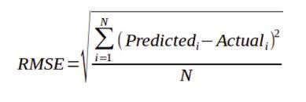
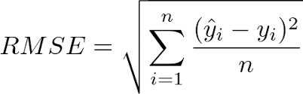
Continuous aka Regression Y
MSE
RMSE

Slide 8
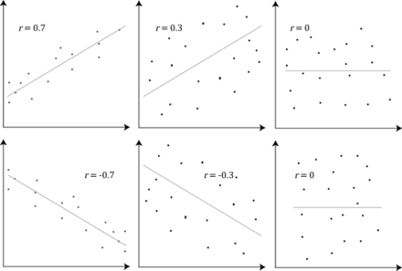
Correlation and Dependence
https://www.wikiwand.com/en/Correlation_and_dependence

Slide 9
When to Use Regression
Supervised Learning (historical labeled data available)
Trend Prediction like
Financial Prediction
Economic Prediction
Pattern Recognition (Business Insights)
Sales
Purchase
Voting Pattern

Slide 10
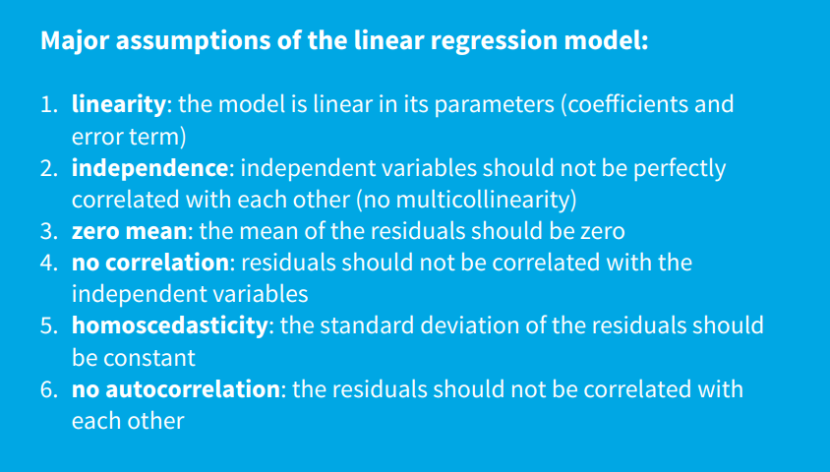
Assumption: Hilpisch Page 34

Slide 11
Regression Interview Questions (Can we answer all after this class)
What are the important assumptions of Linear regression?
What is heteroscedasticity?
What is the difference between R square and adjusted R square?
How to find RMSE and MSE?
What are the possible ways of improving the accuracy of a linear regression model?
How to interpret a Q-Q plot in a Linear regression model?
What is the significance of an F-test in a linear model?
What are the disadvantages of the linear model?
https://www.proschoolonline.com/blog/data-science-interview-questions-on-linear-regression

Slide 12

What is heteroscedasticity?
Heteroscedasticity is exactly the opposite of homoscedasticity, which means that the error terms are not equally distributed.

Slide 13
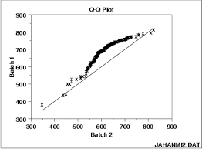
How to interpret a Q-Q plot in a Linear regression model?
A Q-Q plot is used to check the normality of errors. In the above chart mentioned, Majority of the data follows a normal distribution with tails curled. This shows that the errors are mostly normally distributed but some observations may be due to significantly higher/lower values are affecting the normality of errors.

Slide 14
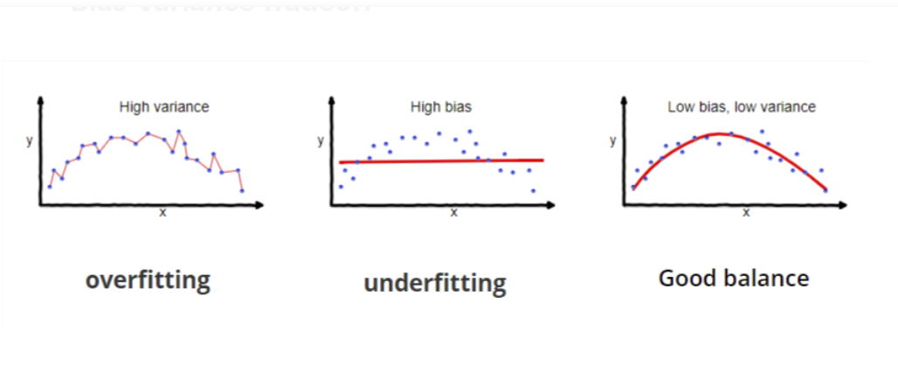
What are the disadvantages of the linear model?
Linear regression is sensitive to outliers which may affect the result.
Over-fitting
Under-fitting

Slide 15
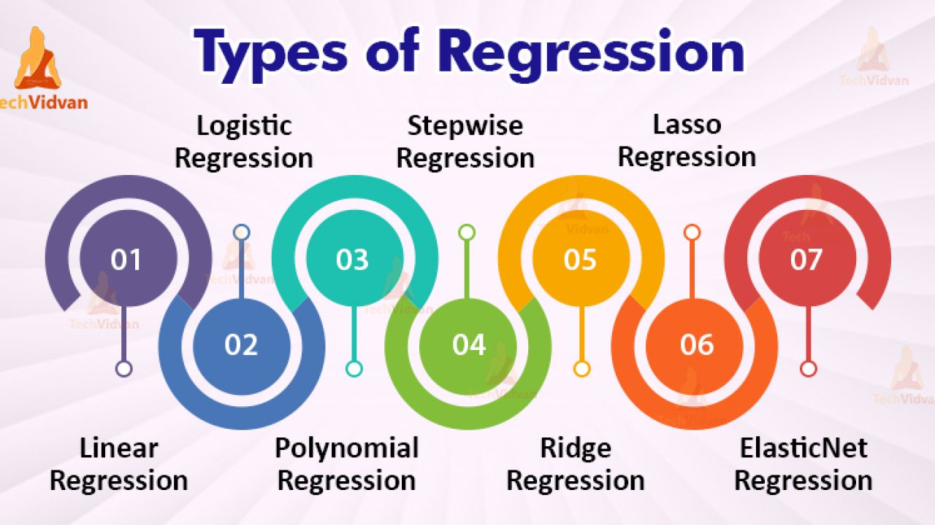
Types of Regression
https://www.youtube.com/watch?v=_3xMSbIde2I
https://www.youtube.com/watch?v=ctmNq7FgbvI

Slide 16
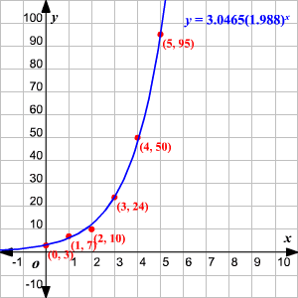

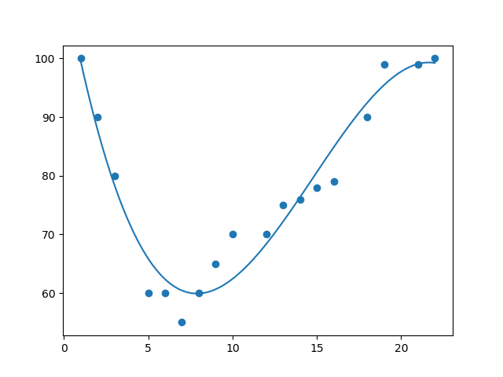
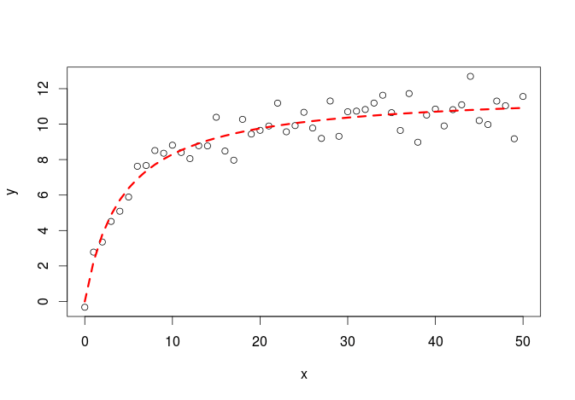
Shape of regression
Linear
Exponential
Polynomial
Logarithm

Slide 17
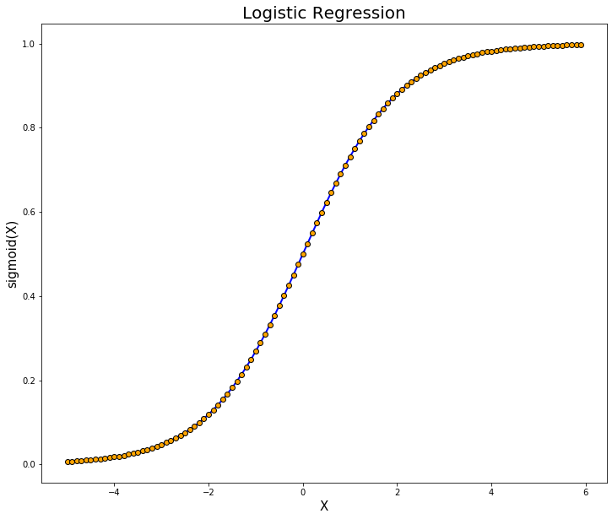
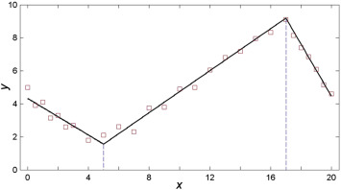
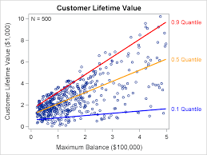
Shape of regression
Logistic
MARS (Adaptive)
Quantile

Slide 18
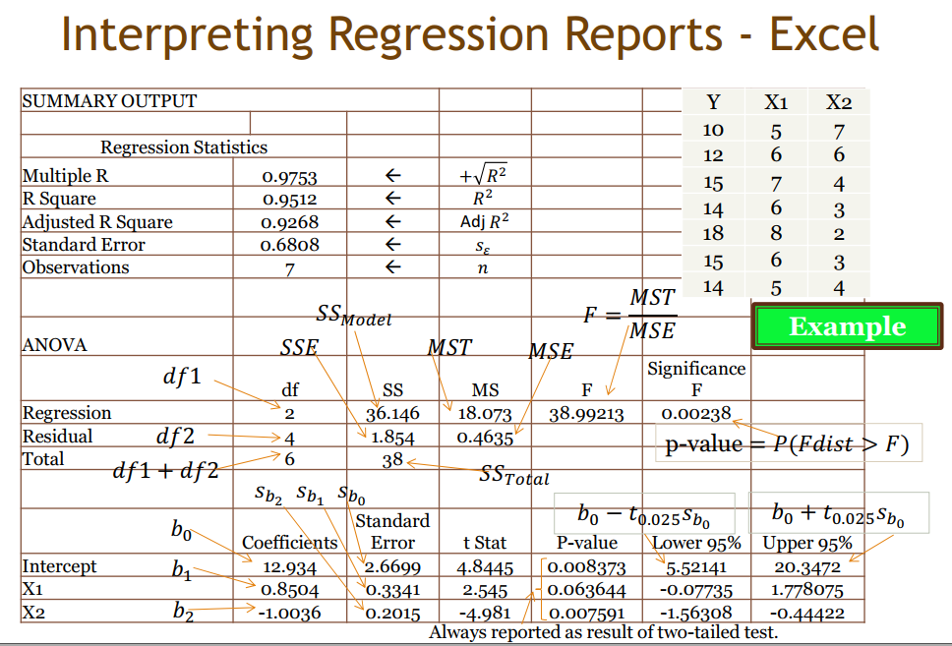
ANOVA Table
R test
F test t test

Slide 19
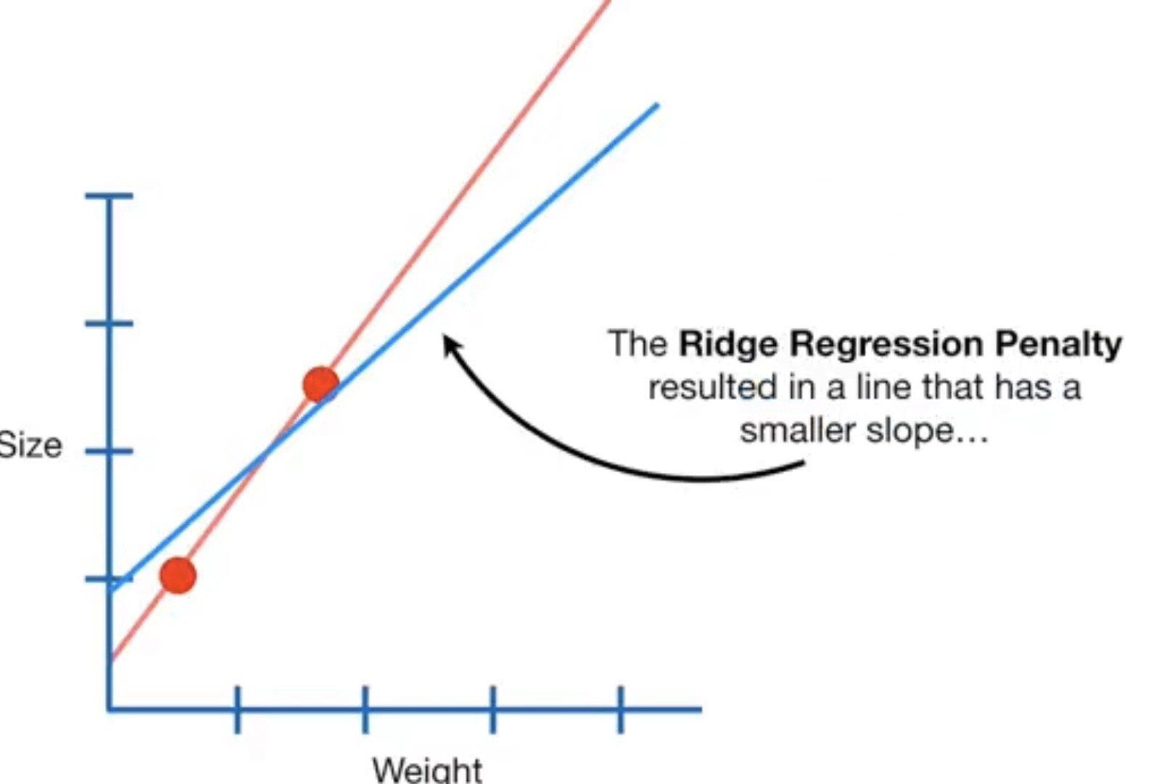
Others
Ridge (reduce the coefficients but NOT to absolute zero)
Lasso regression (make coefficients to absolute zero)

Slide 20
DBS Share Price Example 1. Linear 2. Non-Linear - Polynomial

Slide 21
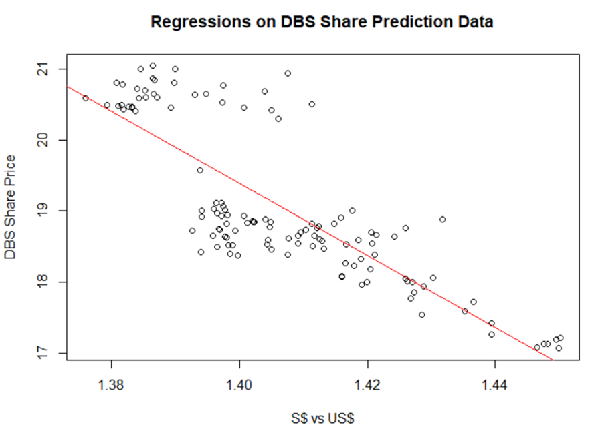
Linear Regression
Y has a linear relationship with the Xs.
Notes:
Error must be random

Slide 22
Data Analysis: When $S Strengthen, will DBS share price up or down?
When Sing Dollar strengthen, DBS share price will be expensive for foreign investor, therefore, DBS price should go down, if everything else remain the same.
However, when Sing Dollar strengthen, DBS asset in S$ will appreciate from foreign investor perspective, hence, if DBS has more Sing Dollar Asset than Liability, DBS share price should go up.
Hence, data analytics is important.

Slide 23
Regression in R
library(data.table)
dt = fread("C:/Users/Teoh Teik Teo/OneDrive - TSS Global Pte. Ltd/TT Library/AI Model/Data/DBS_SingDollar.csv") #alternatively read.csv
model=lm(dt$DBS ~ dt$SGD)
summary(model)
plot(dt$SGD, dt$DBS, main="Regression", xlab = "SGD", ylab="DBS")
abline(model)
pred = predict(model, newdata=dt)
err = dt$DBS - pred
rmse=(mean(err^2)^0.5)
print(rmse)
dt$SGD2 = dt$SGD^2
model=lm(dt$DBS ~ dt$SGD + dt$SGD2)
summary(model)
pred = predict(model, newdata = dt)
err=dt$DBS - pred
rmse = (mean(err^2)^0.5)
print(rmse)

Slide 24
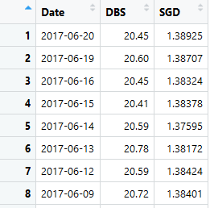
Data : Total 122 rows
R: By double click on the variable at the environment window

Slide 25
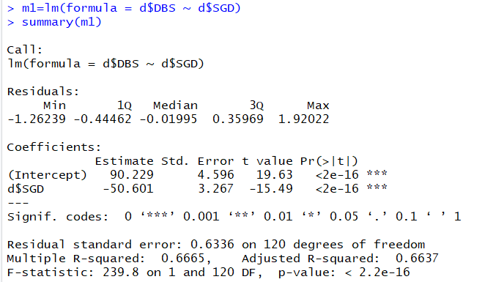

Regression: model=lm(dt$DBS ~ dt$SGD) summary(model)
P-value is very low => SGD is a significant predictor of DBS Share Price or can refer to the star
F-statistic P-value is very low => DBS = -50.601*SGD+90.229 is significant

Slide 26
Activity : What to Predict DBS Share Price base on the formula generated?
DBS = -50.601*SGD+90.229
Machine Learning Process:
After 112 set of data training: We have the coefficient of -50.601 and 90.229.
Testing:
When SGD = 1.38925, what is the error?
When SGD = 1.38707, what is the error?
When SGD = 1.38324, what is the error?
19.93122506 | -0.51877494
20.04153512 | -0.558464884
20.23533673 | -0.214663273

Slide 27
What does the formula means?
DBS = -50.601*SGD+90.229
When Singapore appreciate by 100 basis point, example 1.3800 to 1.3700, then DBS price appreciate by 50.601 * 0.01 = $0.5 (50cents).
By able to predict DBS share price accurately, there is chance that you can buy at lower price if you predict DBS price will appreciate.

Slide 28
Error
pred = predict(model, newdata=dt)
err = dt$DBS - pred
rmse=(mean(err^2)^0.5)
print(rmse)
From F-test, Polynomial is more significant than Linear
How about error? Let us take look at RMSE.
5 types of error:
Error
Square Error
Sum of Square Error
Mean Square Error
Root Mean Square Error

Slide 29
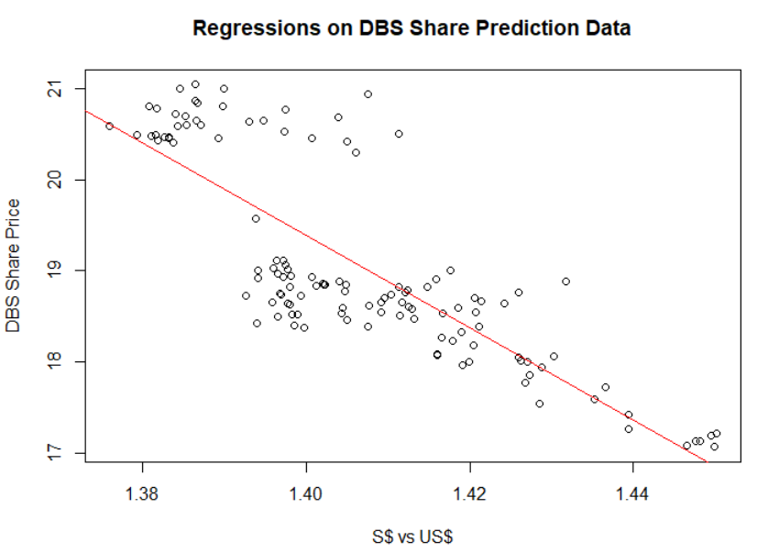
Plot Graph
plot(dt$SGD, dt$DBS, main="Regression Model", xlab = "SGD", ylab="DBS")
abline(model)
What is your conclusion on DBS Price vs Sing$?
Sing$ Strengthen, DBS price goes up
Notes:
Students are expected to look at the difference between the predicted line vs the scattered plot and find other pattern

Slide 30
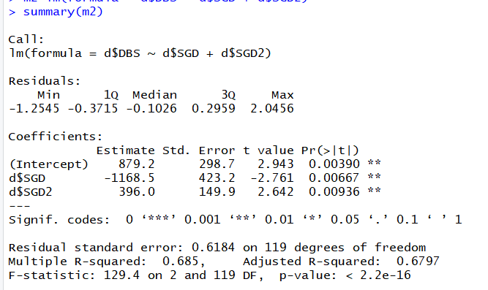
Non-Linear Model
dt$SGD2 = dt$SGD^2
model=lm(dt$DBS ~ dt$SGD + dt$SGD2)
summary(model)
Adjusted R2 for LM

Slide 31
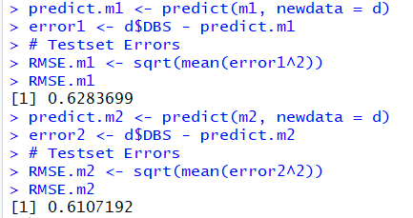
pred = predict(model, newdata = dt)
err=dt$DBS - pred
rmse = (mean(err^2)^0.5)
print(rmse)
Predict is the build in function in R, both data must be in same dimension
Notes:
M2 is better because the RMSE is lower than M1. Significant and Error are related.

Slide 32
Use Python
import pandas as pd
df = pd.read_csv("DBS_SingDollar.csv")
print(df)
X = df.loc[:,["SGD"]]
Y = df.loc[:,['DBS']]
print(X)
from sklearn import linear_model
model = linear_model.LinearRegression()
model.fit(X,Y)
pred = model.predict(X)
from sklearn.metrics import mean_squared_error
rmse = mean_squared_error(Y,pred)**0.5
print(rmse)
print(rmse/Y.mean(axis=0)*100)
#to add polynomial
df["SGD2"] = df["SGD"] ** 2

Slide 33
Dump parameter to external file and load
from joblib import dump
dump(model, 'Regression.joblib’)
from joblib import load
model = load("Regression.joblib")
import pandas as pd
df = pd.read_csv("C:/Users/Teoh Teik Teo/OneDrive - TSS Global Pte. Ltd/TT Library/AI Model/Data/DBS_SingDollar.csv")
X = df.loc[:, ["SGD"]]
pred = model.predict(X)
print(pred)
X = [[1.4]]
pred = model.predict(X)
print(pred)

Slide 34
Ridge and Lasso
model= linear_model.Ridge()
model.fit(X, Y)
pred=model.predict(X)
print(mean_squared_error(pred, Y)**0.5)
model= linear_model.Lasso()
model.fit(X, Y)
pred=model.predict(X)
print(mean_squared_error(pred, Y))

Slide 35
Predict Tesla Beta
import pandas as pd
df = pd.read_csv("Sharpe.csv")
df=df.dropna()
df.describe()
X=df.iloc[:,3:6]
Y=df.iloc[:,6]
print(X,Y)
from sklearn.model_selection import train_test_split
X_train,X_test,Y_train,Y_test = train_test_split(X,Y, test_size=0.3)
from sklearn import linear_model
model = linear_model.LinearRegression()
model.fit(X_train, Y_train)
pred = model.predict(X_train)
from sklearn.metrics import mean_squared_error
rmse = mean_squared_error(pred, Y_train)**0.5
print(rmse)
pred = model.predict(X_test)
rmse = mean_squared_error(pred, Y_test)**0.5
print(rmse)

Slide 36
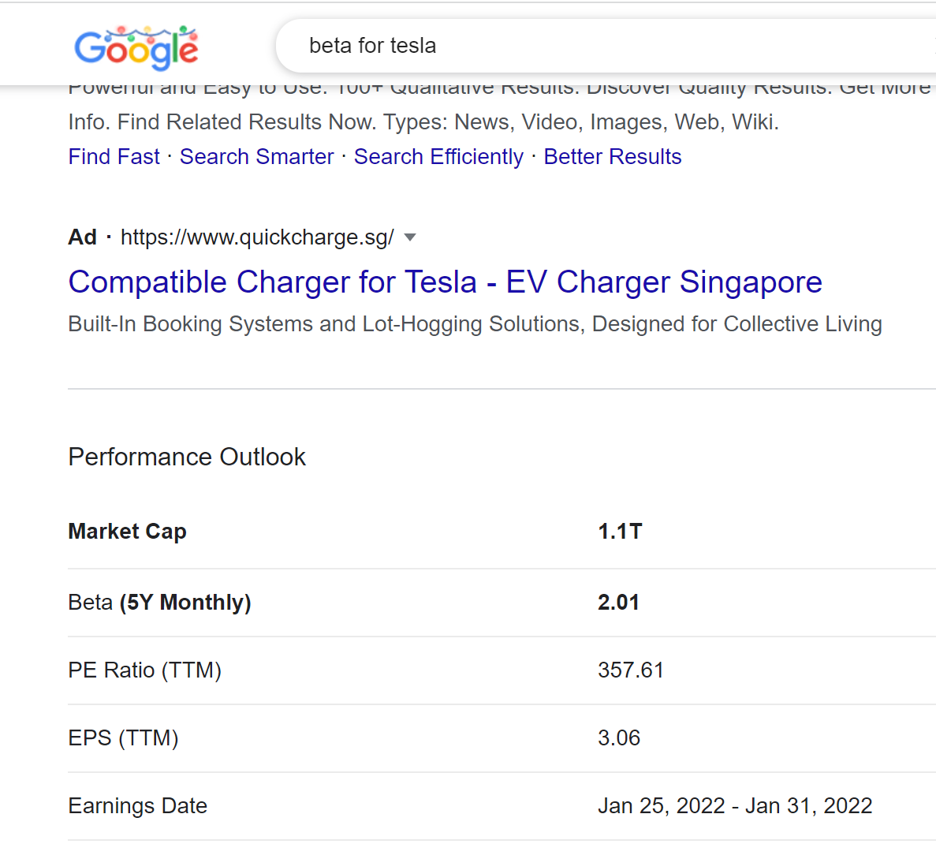
Predict Tesla Beta
# save the model to disk
import pickle
filename = 'finalized_model.sav'
pickle.dump(model, open(filename, 'wb'))
# load the model from disk
model1 = pickle.load(open("finalized_model.sav", "rb"))
X_test = [[0, 1100000, 357]]
pred = model1.predict(X_test)
print(pred)

Slide 37
Activity
Use Excel

Slide 38
Financial Data for Equity

Slide 39
Process
Check any imbalance (Use Smote if Imbalance)
Import data
Select the attribute/feature/X (correlation)
Clean the data (remove NA, not a number and outlier)
Split X,Y
Check Collinearity (VIF)
Visualize the data
Create dummy for categorical X
Normalization if needed
Split train test
Train model
Predict
Results: Metrics (Categorical is confusion matrix, Continuous is RMSE)
QQ plot (check Heteroscedasticity)
Anova (check significant)

Slide 40
Check Imbalance
Use excel – countif
(eg =COUNTIF(I2:I100, "tested_positive")
Imbalance then use smote

Slide 41
Import data & Feature Selection
#replace word with number if needed
df['default'] = df["default"].replace(("Yes", "No"), (0,1))
import pandas as pd
df = pd.read_csv("Equity.csv")
pd.set_option("display.max_columns", None)
pd.set_option("display.max_rows", None)
#feature selection
cor = df.corr()
cor_target = abs(cor["Class"])
#Selecting highly correlated features
features = cor_target[cor_target>0.1]
print(features.sort_values()))
print(df.isnull().sum().sort_values())
df = df.loc[:, ["Class", "Dividend per Share", "10Y Net Income Growth (per Share)", "10Y Shareholders Equity Growth (per Share)"]]
from sklearn.feature_selection import SelectKBest, f_regression
features = SelectKBest(score_func=f_regression, k=5)
fit = features.fit(X, Y)
print(data.columns, fit.scores_)
mask = fit.get_support()
print(mask)
new_features = X.columns[mask]
print(new_features[:])

Slide 42
Data Cleaning and Split X,Y
#Data Cleaning
df = df.dropna()
#split X,Y
Y = df.iloc[:, 0]
X = df.iloc[:, 1:4]
#remove outlier
import numpy as np
from scipy import stats
z = stats.zscore(df.astype(np.float)) #zscore conversion need float
z = np.abs(z) #convert all to positive because the parity is not important
f = (z < 3).all(axis=1) #3 is your choice, axis =1 means by columns, f is a flag
df = df[f]
#remove not a number
for i in df.columns:
df1 = pd.to_numeric(df[i], errors='coerce’)
df=df[df1.notnull()] #make it to null then remove null
print(df)

Slide 43
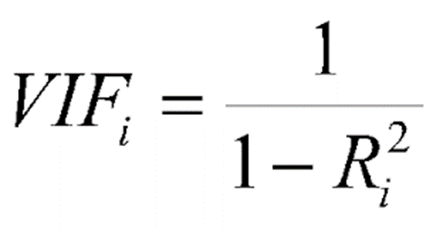
Check Collinearity
#vif to check collinearity
#1 = not correlated.
#Between 1 and 5 = moderately correlated.
#Greater than 5 = highly correlated.
from statsmodels.stats.outliers_influence import variance_inflation_factor
vif_data = pd.DataFrame()
vif_data["feature"] = X.columns
vif_data["VIF"] = [variance_inflation_factor(X.values, i) for i in range(len(X.columns))]
print(vif_data)

Slide 44
Data Visualization
df.hist()
import seaborn as sns
sns.heatmap(df.corr())

Slide 45
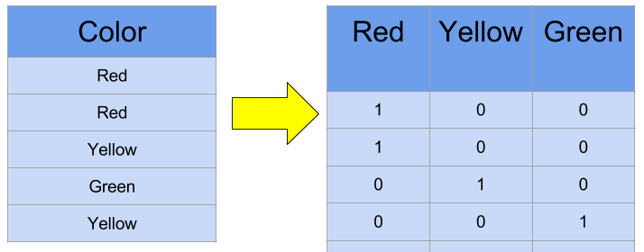
Normalization & Create Dummy for Categorical X
#normalization
from scipy import stats
import numpy as np
pd.set_option('display.max_rows', 10)
for i in X.columns:
X[i]=stats.zscore(X[i].astype(np.float))
print(X)
#X is categorical
dummy=pd.get_dummies(X["rating"])
X=X.merge(dummy, left_index=True, right_index=True)
X=X.drop("rating", axis="columns")

Slide 46
Split train test, train, predict
from sklearn.model_selection import train_test_split
X_train, X_test, Y_train, Y_test = train_test_split(X,Y, test_size=0.3)
print(X_train, X_test, Y_train, Y_test )
from sklearn import linear_model
model = linear_model.LogisticRegression()
model.fit(X_train, Y_train)
pred = model.predict(X_train)
from sklearn.metrics import confusion_matrix
cm = confusion_matrix(Y_train, pred)
print(cm)
accuracy = (cm[0,0]+cm[1,1])/sum(sum(cm))
print(accuracy)
pred = model.predict(X_test)
cm = confusion_matrix(Y_test, pred)
print(cm)
accuracy = (cm[0,0]+cm[1,1])/sum(sum(cm))
print(accuracy)

Slide 47
Export the coefficient for testing/prediction Save and Load
# save the model to disk
import pickle
pickle.dump(model, open("RegressionEquityModel", 'wb'))
# load the model from disk
model1 = pickle.load(open('finalized_model.sav', 'rb'))
pred = model1.predict(X_test)
cm = confusion_matrix(Y_test, pred)
print(cm)
accuracy = (cm[0,0]+cm[1,1])/sum(sum(cm))
print(accuracy)

Slide 48
Predict Only (totally new data)
import pickle
model = pickle.load(open('/content/RegressionEquityModel', 'rb'))X_predict = [[0, 0.2, 0.2]]
pred = model.predict(X_predict)
print(pred)
#from file
import pandas as pd
df = pd.read_csv("Equity (Predict).csv")
X_predict = df.loc[:, ["Dividend per Share", "10Y Net Income Growth (per Share)", "10Y Shareholders Equity Growth (per Share)"]]
X_predict = X_predict.dropna()
# load the model from disk
pred = model1.predict(X_predict)
print(pred)

Slide 49
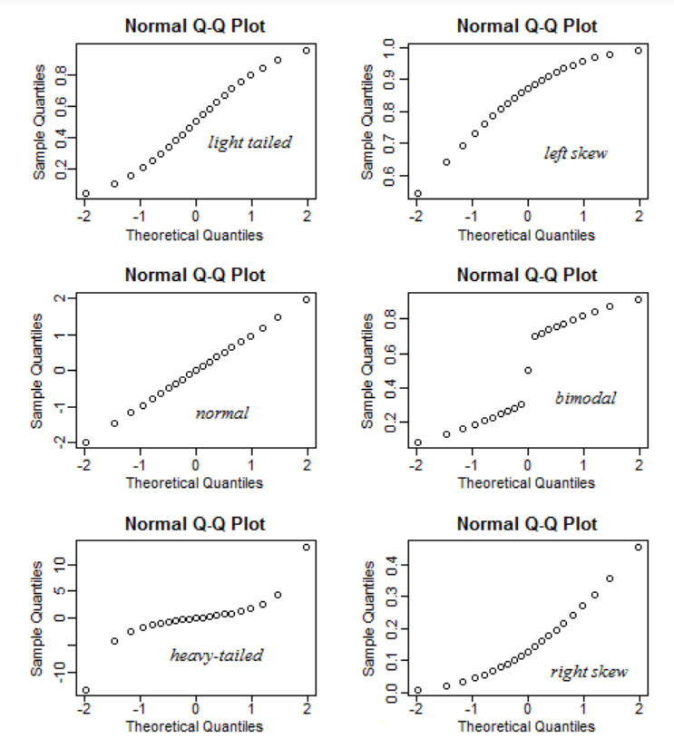
QQ plot - check heteroskedasticity – residual must be normally distributed
import statsmodels.api as sm
from matplotlib import pyplot as plt
mod_fit = sm.OLS(Y,X).fit()
res = mod_fit.resid # residuals
fig = sm.qqplot(res)
plt.show()

Slide 50
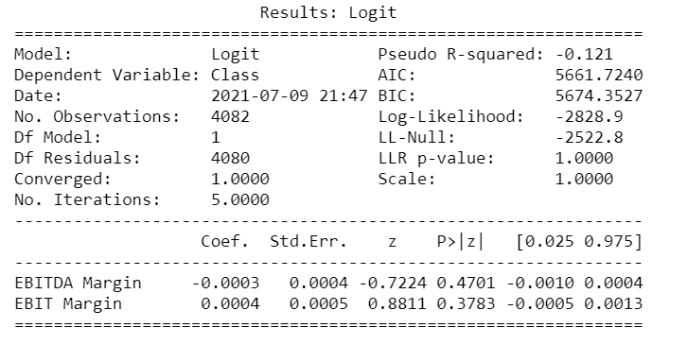
Anova
import statsmodels.api as sm
model=sm.Logit(Y,X)
result=model.fit()
print(result.summary2())

Slide 51
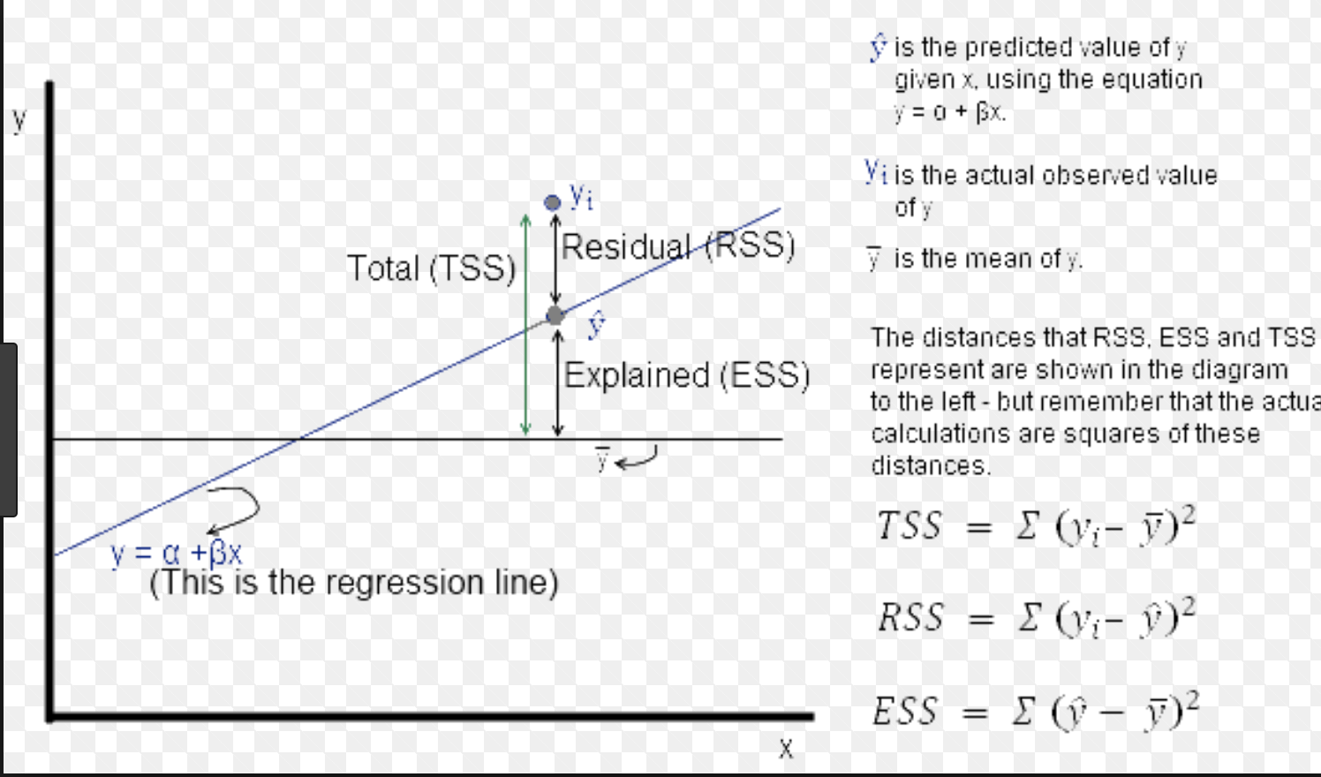
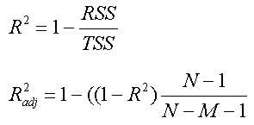
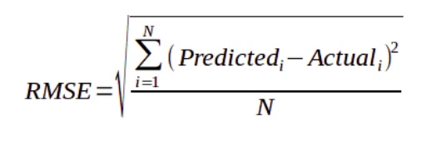
AIC Rsq RMSE
AIC = 2k + n ln(RSS)
RMSE no K
AIC reduce the weight of error but increase the weight of # of independent variable
Rsq using TSS, like ratio style, therefore max is 1
RSS

Slide 52
If you need to set threshold, use predict_prob
from sklearn import linear_model
from sklearn.metrics import confusion_matrix
import numpy as np
model=linear_model.LogisticRegression()
model.fit(X_train, Y_train)
THRESHOLD = 0.45
pred = model.predict_proba(X_train)
# [:,1] taking all rows (:) but keeping the second column (1) proba return 2 columns
pred = np.where(pred[:,1] > THRESHOLD, 1, 0)
cm = confusion_matrix(pred, Y_train)
print(cm)
accuracy = (cm[0,0] + cm[1,1])/sum(sum(cm))
print(accuracy)
pred=model.predict(X_test)
pred = model.predict_proba(X_test)
# [:,1] taking all rows (:) but keeping the second column (1) proba return 2 columns
pred = np.where(pred[:,1] > THRESHOLD, 1, 0)
cm = confusion_matrix(pred, Y_test)
print(cm)
accuracy = (cm[0,0] + cm[1,1])/sum(sum(cm))
print(accuracy)

Slide 53
from sklearn import tree
model = tree.DecisionTreeClassifier()
model.fit(X_train, Y_train)
pred = model.predict(X_train)
from sklearn.metrics import confusion_matrix
cm = confusion_matrix(pred, Y_train)
print(cm)
accuracy = (cm[0,0]+cm[1,1])/sum(sum(cm))
print(accuracy)
pred = model.predict(X_test)
cm = confusion_matrix(pred, Y_test)
print(cm)
accuracy = (cm[0,0]+cm[1,1])/sum(sum(cm))
print(accuracy)
Decision Tree for comparison

Slide 54
Treynor Ratio Example with Data Wrangling Using Python

Slide 55
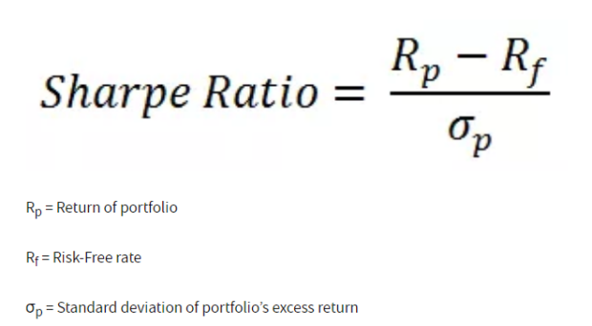
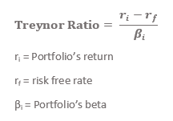
Treynor

Slide 56
Select columns
import pandas as pd
df = pd.read_csv("Treynor.csv")
print(df)
#pd.set_option('display.max_columns', 100)
pd.set_option('display.max_rows', 20)
cor = df.corr()
cor_target = abs(cor["category_treynor_ratio_10years"])
#Selecting highly correlated features
relevant_features = cor_target[cor_target>0.1]
print(relevant_features.sort_values())
print(df.isnull().sum().sort_values())
df = df.loc[:,["asset_others", "price_earnings_ratio", 'sector_communication_services', "credit_b", "category_treynor_ratio_10years"]]

Slide 57
Remove null and not a number
#remove na
df=df.dropna()
print(df)
#remove not a number
for i in df.columns:
df1 = pd.to_numeric(df[i], errors='coerce’)
df=df[df1.notnull()] #make it to null then remove null
print(df)

Slide 58
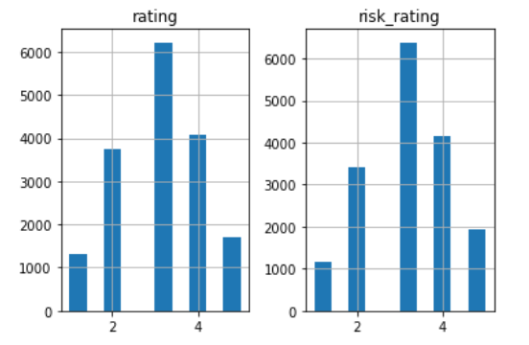
Histogram
df.hist()
import matplotlib.pyplot as plt

Slide 59
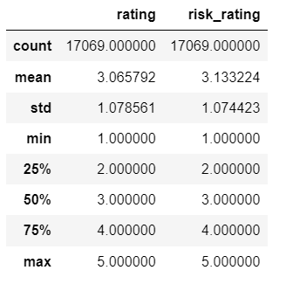
describe
df.describe()

Slide 60
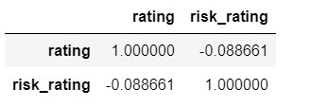
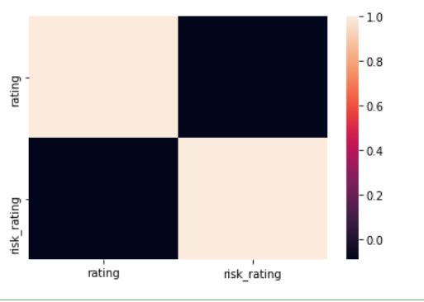
Correlation – check co-linearity, the relationship between the independent variable
df.corr()
import seaborn as sns
sns.heatmap(df.corr())

Slide 61
Split X and Y
X = df.iloc[:, 0:4]
Y = df.iloc[:, 4]

Slide 62
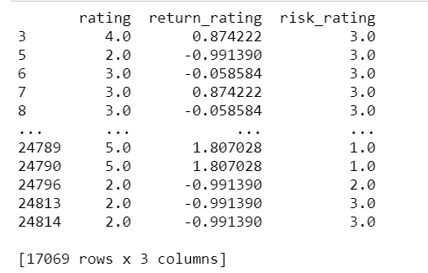
Normalization
#normalization
from scipy import stats
import numpy as np
pd.set_option('display.max_rows', 10)
for i in X.columns:
X[i]=stats.zscore(X[i].astype(np.float))
print(X)

Slide 63
Categorical Input
dummy=pd.get_dummies(X["rating"])
X=X.merge(dummy, left_index=True, right_index=True)
X=X.drop("rating", axis="columns")

Slide 64
Train Test Split
#split train test
from sklearn.model_selection import train_test_split
X_train, X_test, Y_train, Y_test = train_test_split(X, Y, test_size=0.3)
print(X_train, X_test, Y_train, Y_test)

Slide 65
Linear Regression
from sklearn import linear_model
from sklearn.metrics import mean_squared_error
model=linear_model.LinearRegression()
model.fit(X_train, Y_train)
pred=model.predict(X_train)
rmse=mean_squared_error(pred, Y_train)**0.5
print(rmse)
#median = df["fund_treynor_ratio_10years"].median()
pred=model.predict(X_test)
rmse=mean_squared_error(pred, Y_test)**0.5
print(rmse)

Slide 66
Lasso and Ridge
model= linear_model.Ridge()
model.fit(X_train, Y_train)
pred=model.predict(X_test)
print(mean_squared_error(pred, Y_test)**0.5)
model= linear_model.Lasso()
model.fit(X_train, Y_train)
pred=model.predict(X_test)
print(mean_squared_error(pred, Y_test)**0.5)

Slide 67
Test against Decision Tree
from sklearn import tree
model = tree.DecisionTreeRegressor()
model.fit(X_train, Y_train)
pred = model.predict(X_train)
rmse=mean_squared_error(pred, Y_train)**0.5
print(rmse)
pred=model.predict(X_test)
rmse=mean_squared_error(pred, Y_test)**0.5
print(rmse)

Slide 68
Optional: Select Features
import pandas as pd
import numpy as np
data = pd.read_csv("Treynor.csv")
data.columns
data = data.dropna()
X = data.iloc[:,16:30]
Y = data.iloc[:,-1]
from sklearn.feature_selection import SelectKBest, f_regression
features = SelectKBest(score_func=f_regression, k=5)
fit = features.fit(X, Y)
print(data.columns, fit.scores_)
mask = fit.get_support()
print(mask)
new_features = X.columns[mask]
print(new_features[:])

Slide 69
Other Considerations
Multicollinearity – Relationship Between Variable
Time Series – Correlation between the rows
Notes:
Teach later in the class

Slide 70
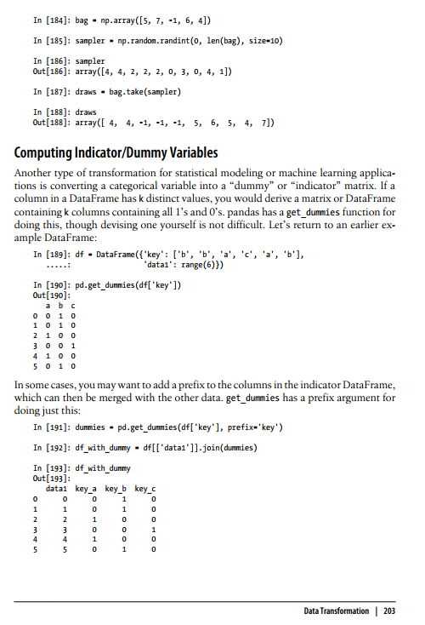
Categorical Input
Get_dummy (McKinney pg 203)

Slide 71
What have you learnt?
Regression as Prediction
Types of Regression
Other consideration

Slide 72
Reading Material (Optional)
Shwartz Pg 124 to 130 https://www.dropbox.com/s/ed9s6zyrtjgc7dk/Shwartz.pdf?dl=0
Video
https://www.youtube.com/watch?v=WWqE7YHR4Jc&t=440s
https://www.youtube.com/watch?v=aq8VU5KLmkY
Homework (optional) 25 Questions
https://blog.uwgb.edu/bansalg/statistics-data-analytics/linear-regression/

Slide 73
Thank you

